Slide 1
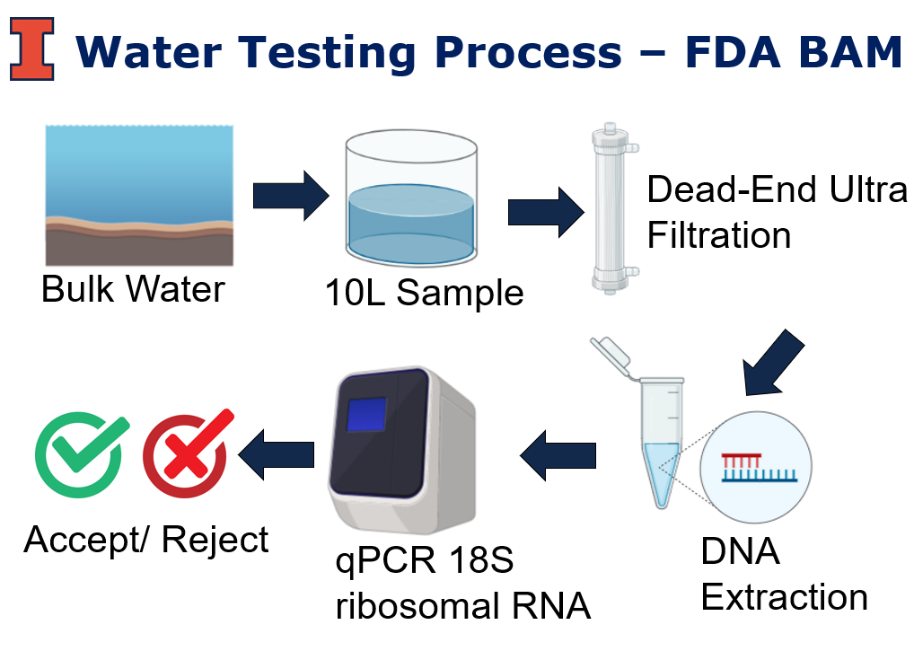
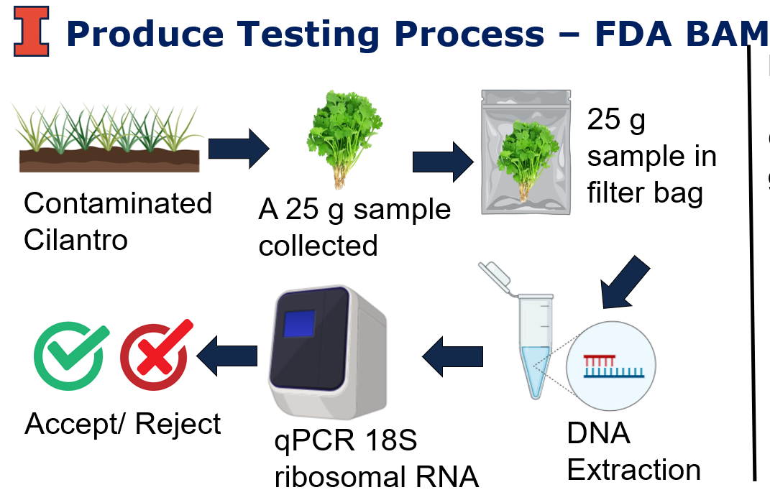

Slide 2
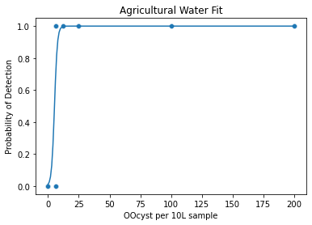
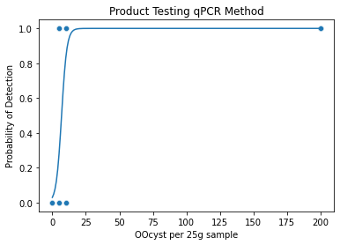

Slide 3
Water Testing
Total oocyst based on Opl levels 0-20
Binomial (sample volume/bulk water volume)
Bulk Water
Total Oocysts
10L Sample
Total Oocysts in sample
Fit (Oocyst in sample)
Probability of Detection
Ifelse(unif <Pdetect)
Detect Yes or No
Product Testing
Total oocyst based on 0 -10,000,000
SRS
Field (20,000) partitions
Total Oocysts
Binomial (grab weight/partition volume)
Total Oocysts in the grab
Aggregate all grabs that add up to the total sample size (25g)
Total Oocyst per (25g) sample
Fit (Oocyst in sample)
Probability of Detection
Detect Yes or No
Ifelse(unif <Pdetect)
Sum
Highest leve:l 20 Opl, over 45 days ~ 10,000,000 Oocysts.

Slide 4
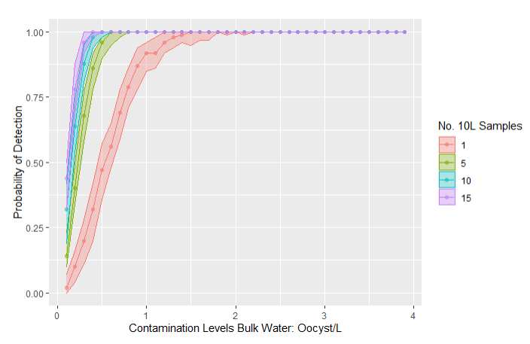
Repeat for different No. Samples
Repeat for each cont. level
100 different fields
Product Testing (Yes/No)
100 times
P detect
Range of
P detect
Repeat for different No. Samples
Repeat for each cont. level
Repeat 100 Times
Product Testing (Yes/No)
100 times
P detect
Range of
P detect

